Slide 1
2-BIT MULTIPLIER
Presented By:
MD Shakibur Rahman (2014-1-60-032)
FariaNawrine (2015-1-60-065)
MD. Ashraful Islam (2015-1-60-071)
Shahrier Sarder Shoumik (2015-1-60-081)

Slide 2
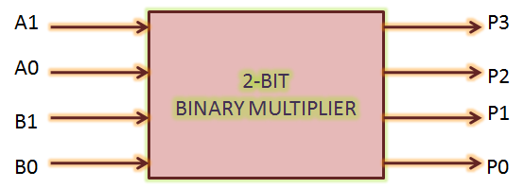
Problem statement:
A=A₁ A₀is a 2-bit multiplicand
and B = B₁ B₀is a 2-bit multiplier.
R=R₃ R₂ R₁ R₀is the 4-bit product.
That means R=A×B.

Slide 3
Implementation
2-bit Let us implement a two bit binary multiplier. Let the two binary numbers be A₁A₀ and B₁B₀. The multiplication table will, then, look as:
A₁ A₀
X B₁ B₀
B₁A₁ B₀A₀
B₁A₁ B₁A₀ x
R3 R2 R1 R0

Slide 4
Design Details: Truth Table
Input |  |  |  | Output
A1 | A0 | B1 | B0 | R3 | R2 | R1 | R0
0 | 0 | 0 | 0 | 0 | 0 | 0 | 0
0 | 0 | 0 | 1 | 0 | 0 | 0 | 0
0 | 0 | 1 | 0 | 0 | 0 | 0 | 0
0 | o | 1 | 1 | 0 | 0 | 0 | 0
0 | 1 | 0 | 0 | 0 | 0 | 0 | 0
0 | 1 | 0 | 1 | 0 | 0 | 0 | 1
0 | 1 | 1 | 0 | 0 | 0 | 1 | 0
0 | 1 | 1 | 1 | 0 | 0 | 1 | 1
1 | 0 | 0 | 0 | 0 | 0 | 0 | 0
1 | 0 | 0 | 1 | 0 | 0 | 1 | 0
1 | 0 | 1 | 0 | 0 | 1 | 0 | 0
1 | 0 | 1 | 1 | 0 | 1 | 1 | 0
1 | 1 | 0 | 0 | 0 | 0 | 0 | 0
1 | 1 | 0 | 1 | 0 | 0 | 1 | 1
1 | 1 | 0 | 0 | 0 | 1 | 1 | 0
1 | 1 | 0 | 1 | 1 | 0 | 0 | 1
0

Slide 5
K-Maps
 | B₁ B₀
A₁ A₀ |  | 00 | 01 | 11 | 10
 | 00 | 0 | 0 | 0 | 0
 | 01 | 0 | 0 | 0 | 0
 | 11 | 0 | 0 | 1 | 0
 | 10 | 0 | 0 | 0 | 0
 | B₁ B₀
A₁ A₀ |  | 00 | 01 | 11 | 10
 | 00 | 0 | 0 | 0 | 0
 | 01 | 0 | 0 | 0 | 0
 | 11 | 0 | 0 | 0 | 1
 | 10 | 0 | 0 | 1 | 1
1
1
1
1 1
R₂ = A₁A '₀B₁ + A₁B₁ B'₀
R₃ = A₁A₀ B₁ B₀
 | B₁ B₀
A₁ A₀ |  | 00 | 01 | 11 | 10
 | 00 | 0 | 0 | 0 | 0
 | 01 | 0 | 0 | 1 | 1
 | 11 | 0 | 1 | 0 | 1
 | 10 | 0 | 1 | 1 | 0
 | B₁ B₀
A₁ A₀ |  | 00 | 01 | 11 | 10
 | 00 | 0 | 0 | 0 | 0
 | 01 | 0 | 1 | 1 | 0
 | 11 | 0 | 1 | 1 | 0
 | 10 | 0 | 0 | 0 | 0
1
1
1
1 1
1 1
1
1
1 1
R₁ = A₁B’₁ B₀ + A₁A’₀B₀ + A’₁ A₀B₁ + A₀B₁ B’₀
R₀ = A₀ B₀

Slide 6
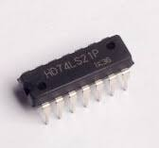
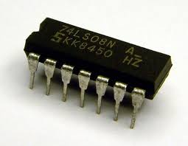
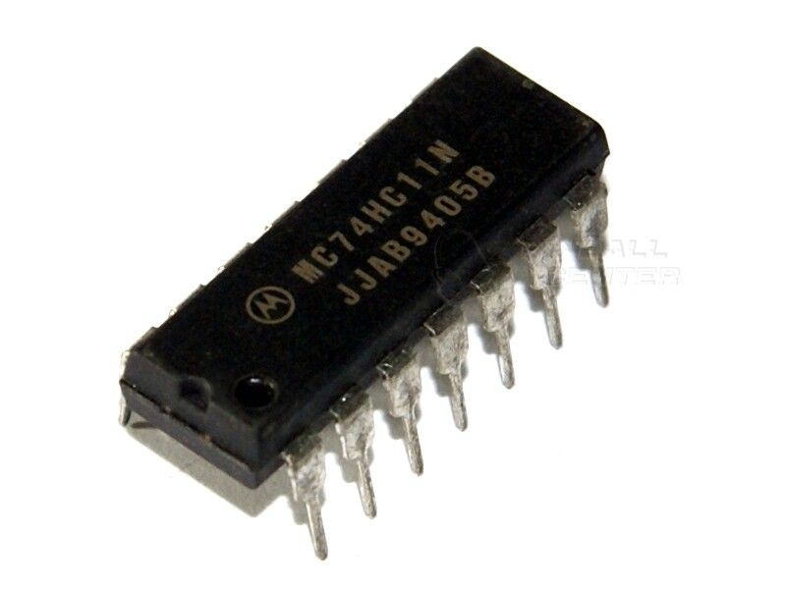
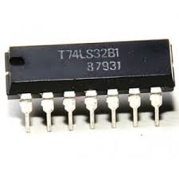
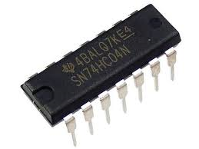
Gates:
7421(4 input and) gate
7408(2 input and) Gate
7411(3 input and) Gate
7432(2 input or gate)
7404(not gate)
Notes:
7404(not gate)

Slide 7
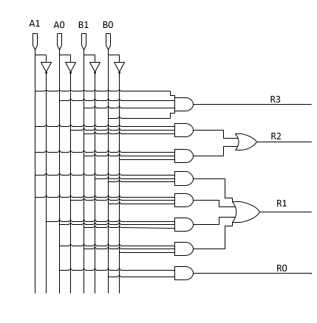
Circuit Diagram
Notes:
Circuit Diagram

Slide 8
Any Question???

Slide 9


